Slide 1
Water Safety
Progression Step 3

Slide 2



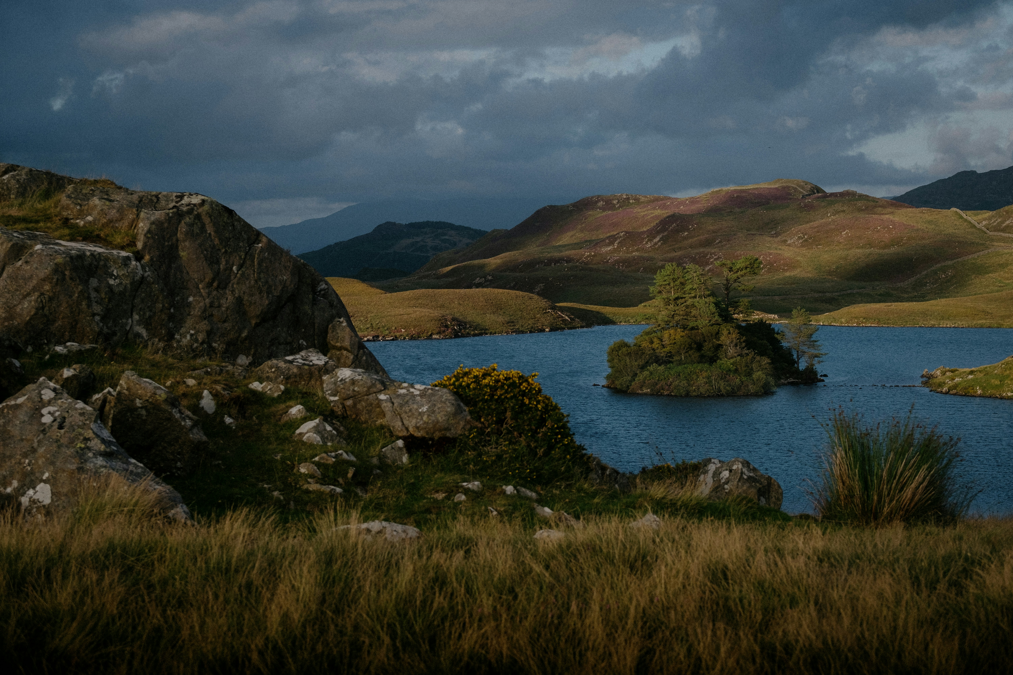
Learning Objectives
Discuss possible dangers in or near water
Consider how I can
keep myself and
others safe when
in or near water.

Slide 3




Word Bank and Water Safety Code
Stop and Think
Stay Together
Float
Call 999
in an Emergency
Cold water
Staying safe
Weather
Dangers
Depth
Strength of water
Hidden dangers
Temperature of water
Risk assessment
Stay close to an
adult/parent/guardian
Keep within your depth
Be prepared for a trip
Emergency
Floating
Buoyancy
Relax/Be calm
999
Treading water
Coastguard
Police
Fire Service
Shout for help
Get an adult

Slide 4
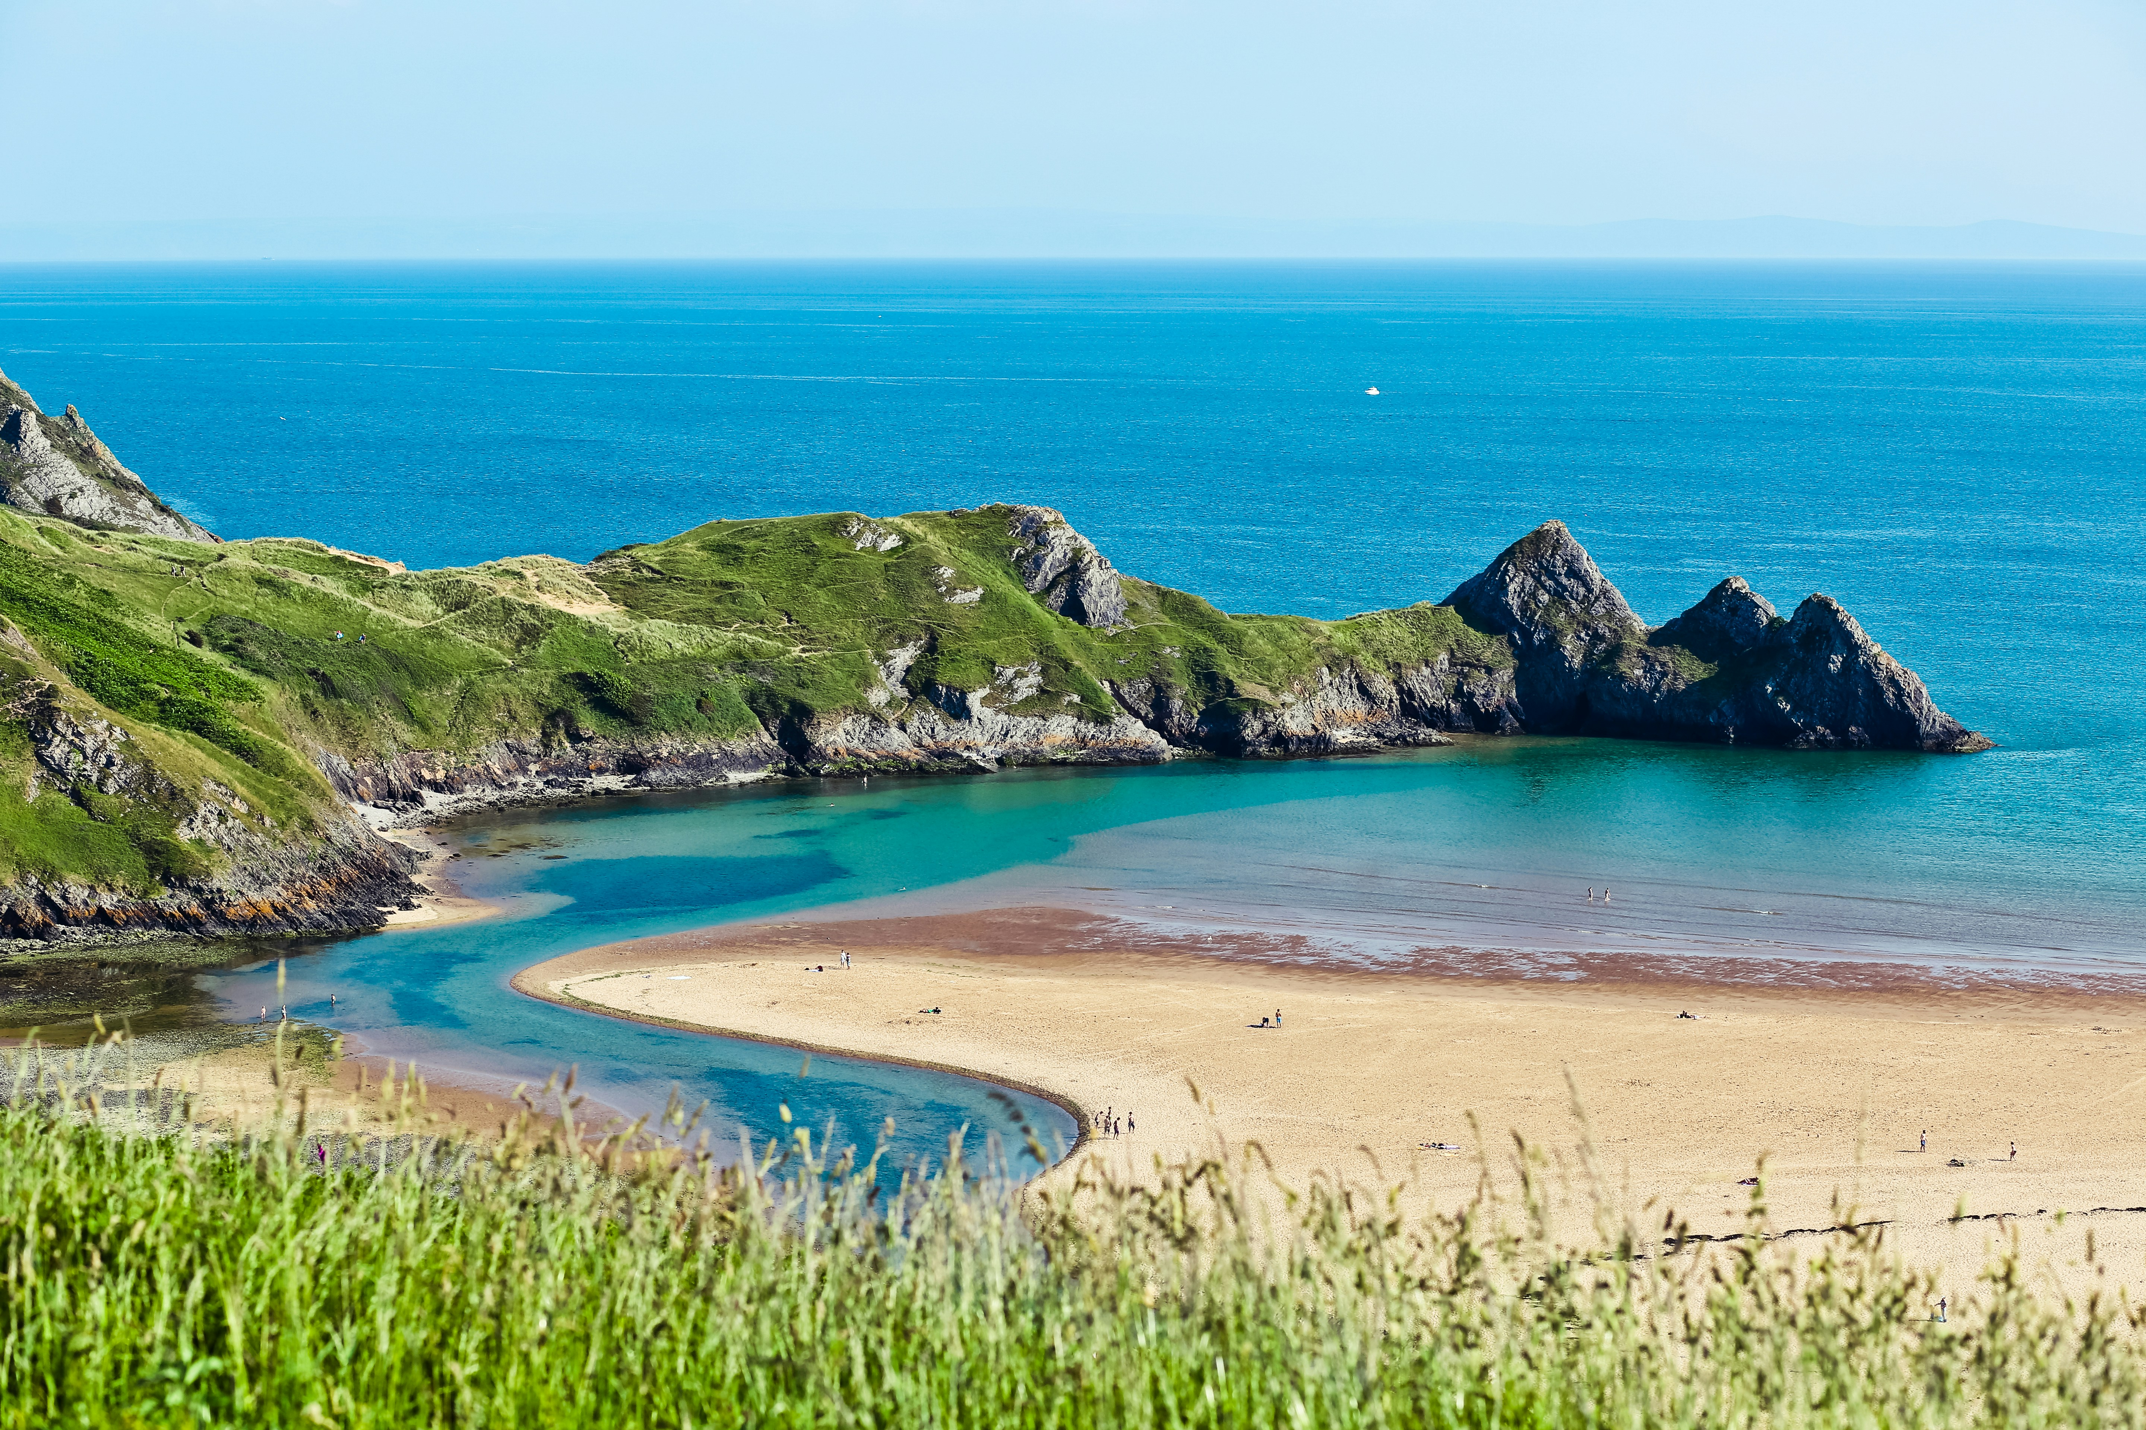
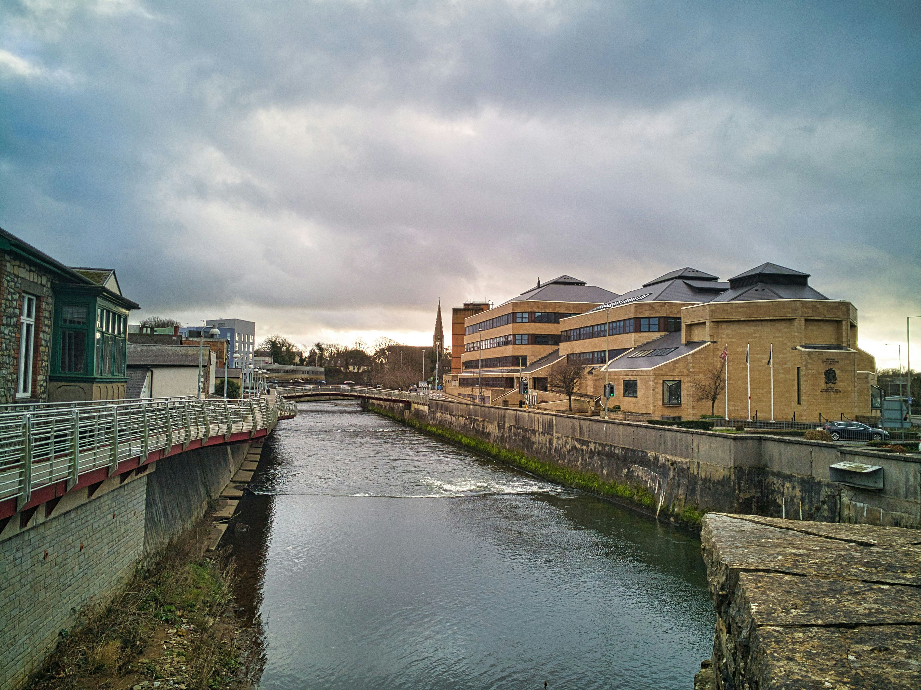
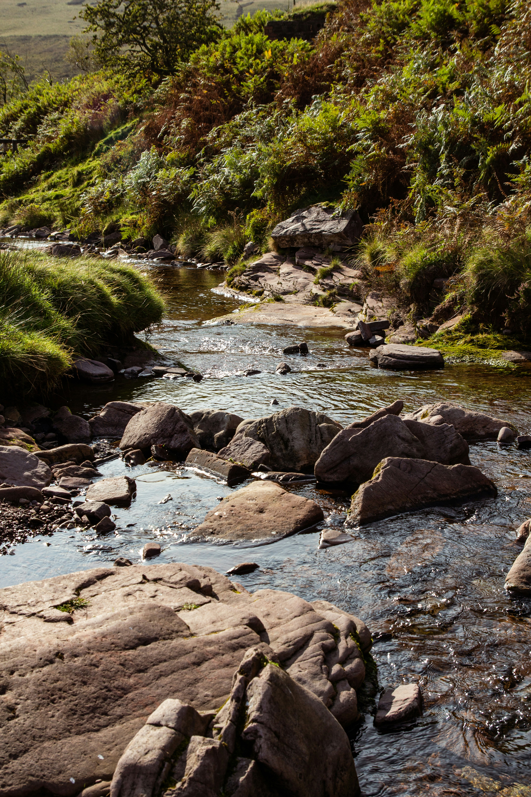

Activity 1 (Starter) Why is it important to be careful around the Water?
Stop and Think
What activities do you do that are in or near water?

Slide 5
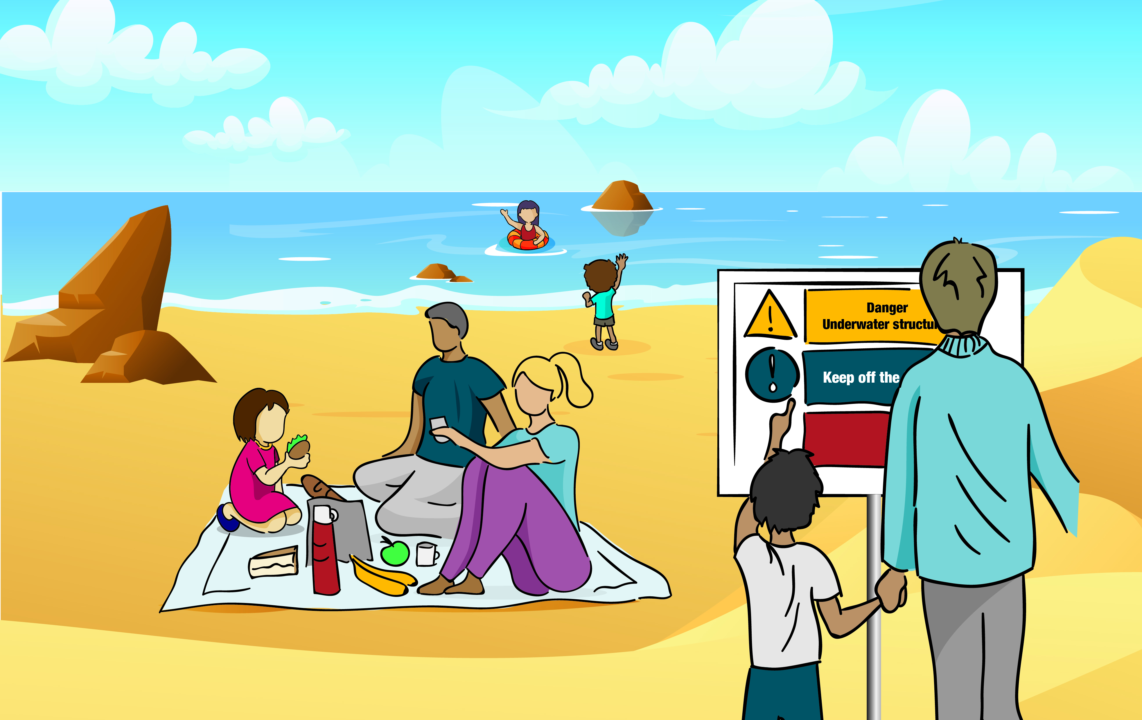
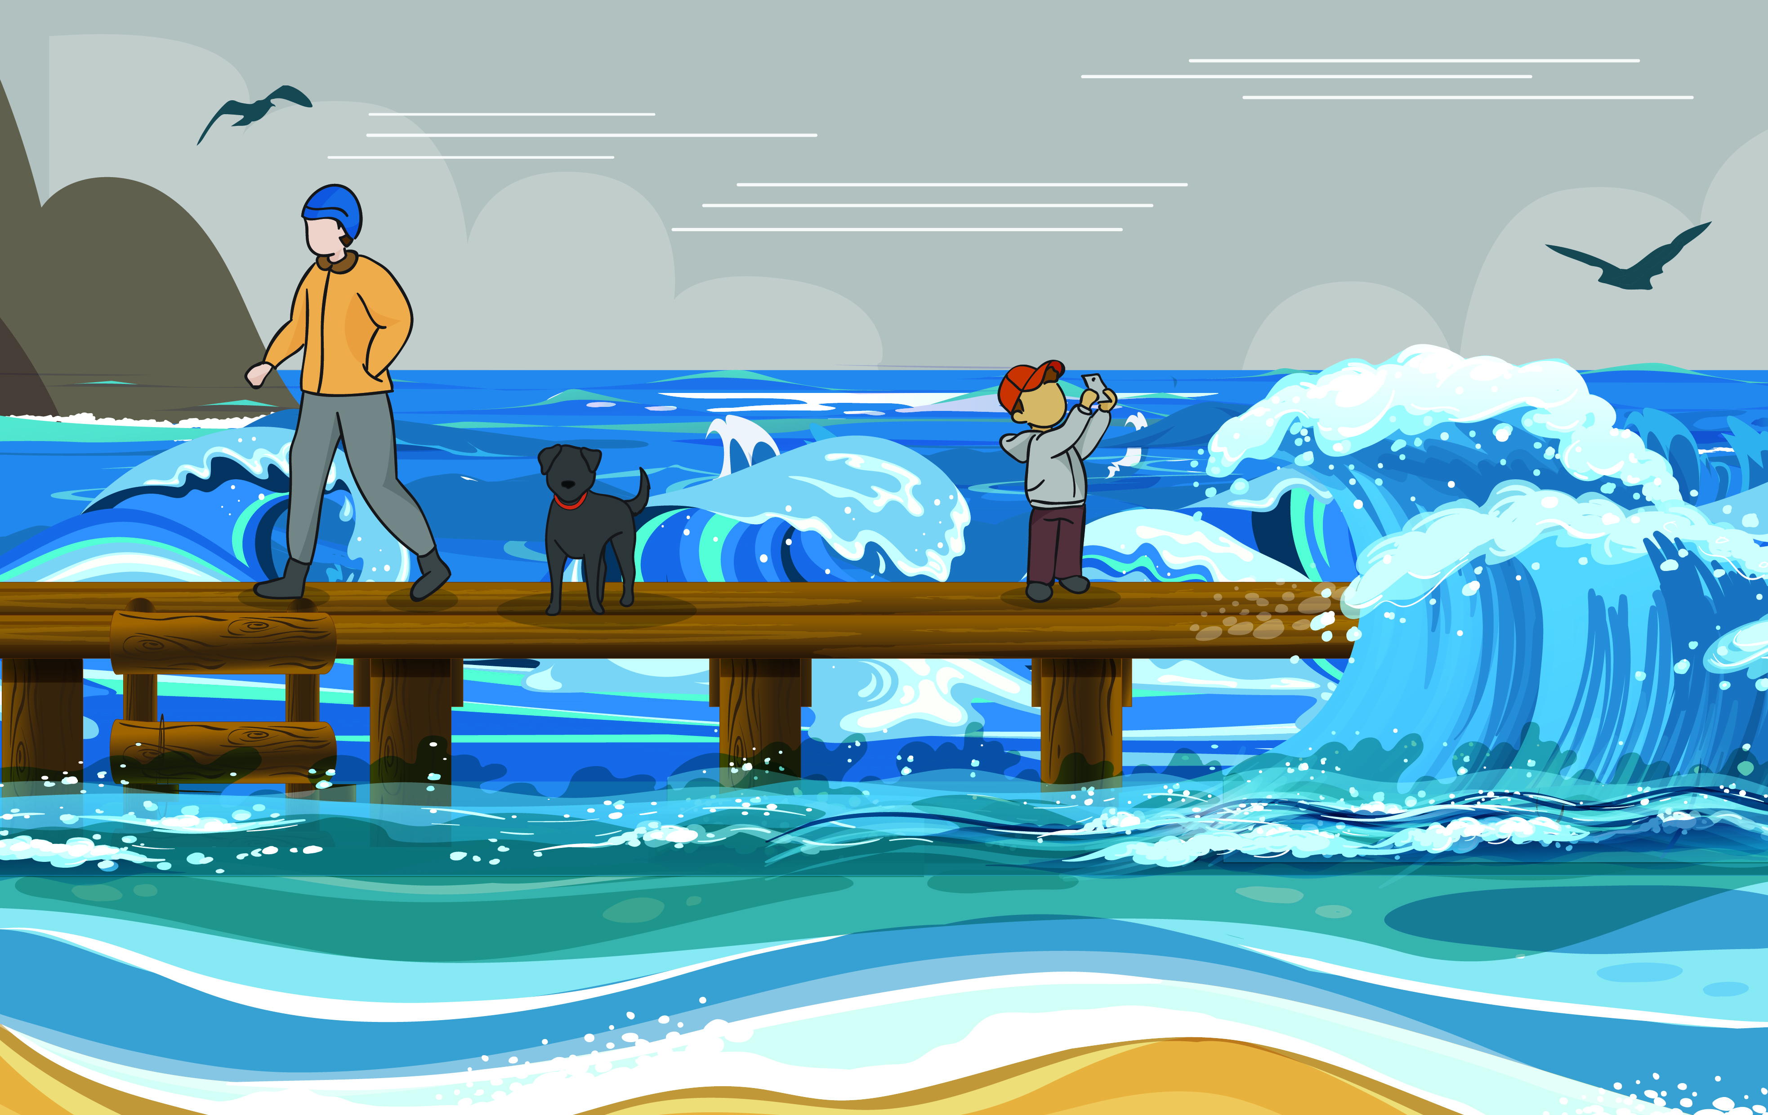
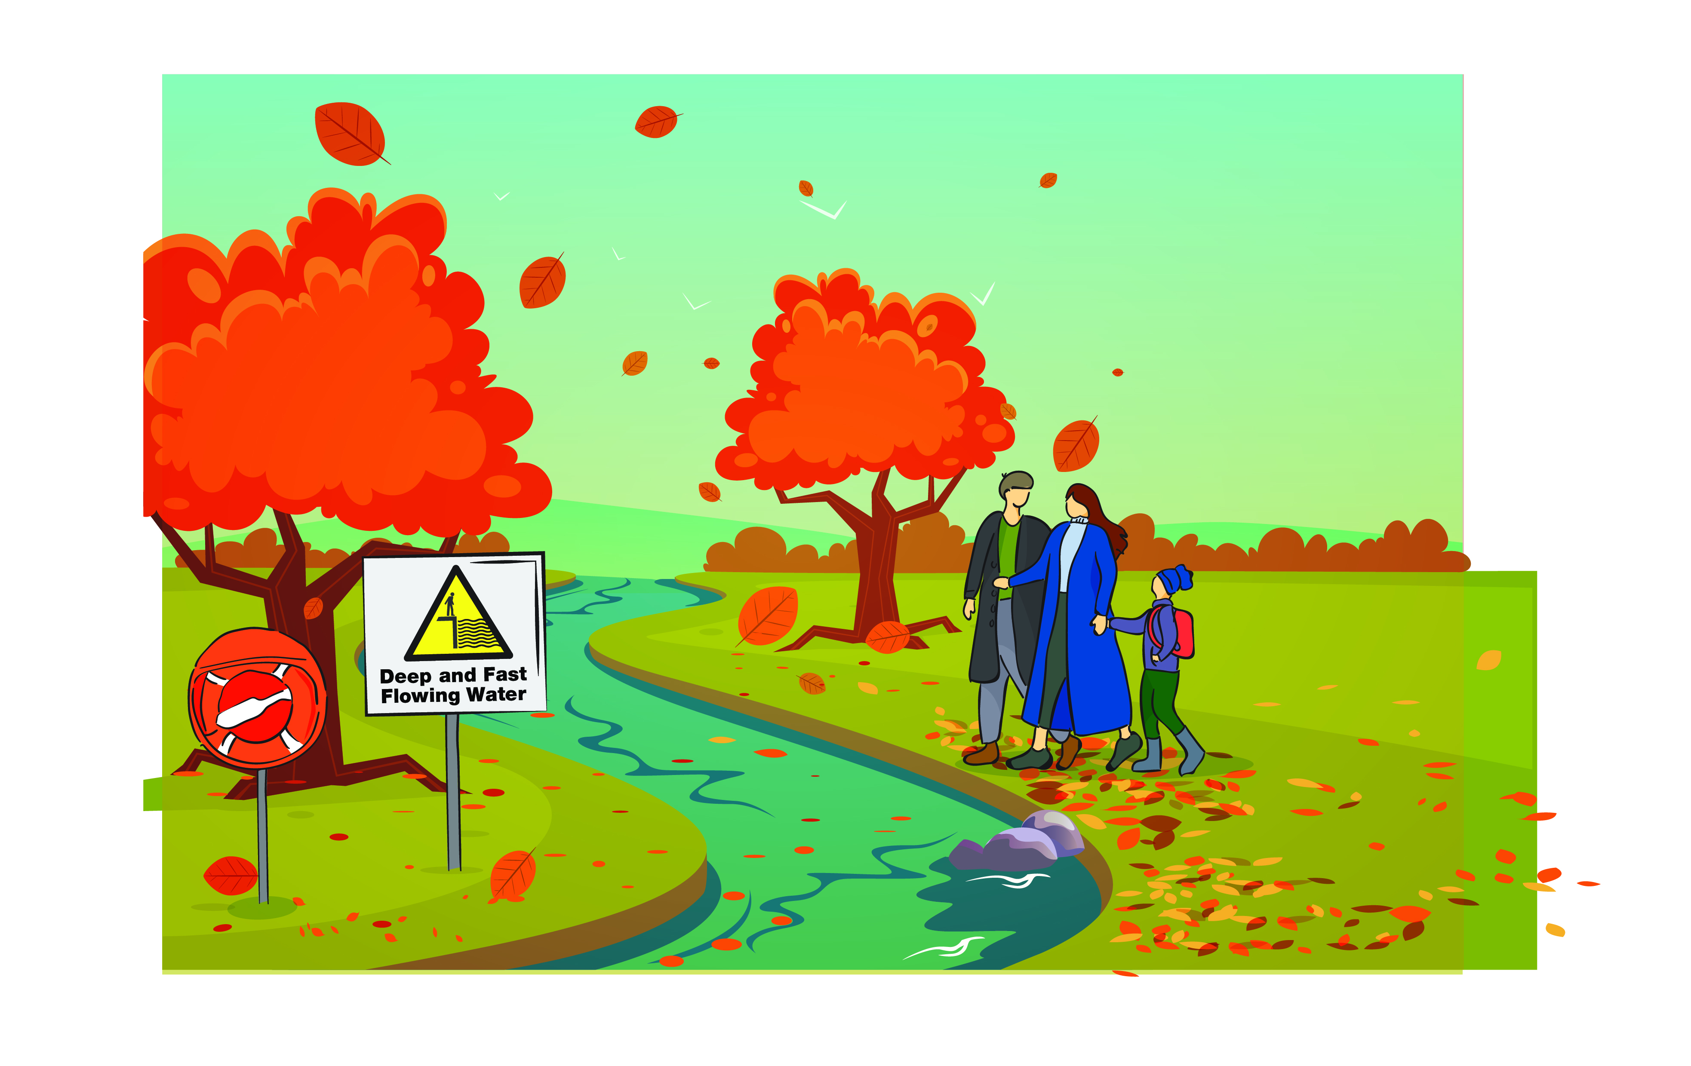
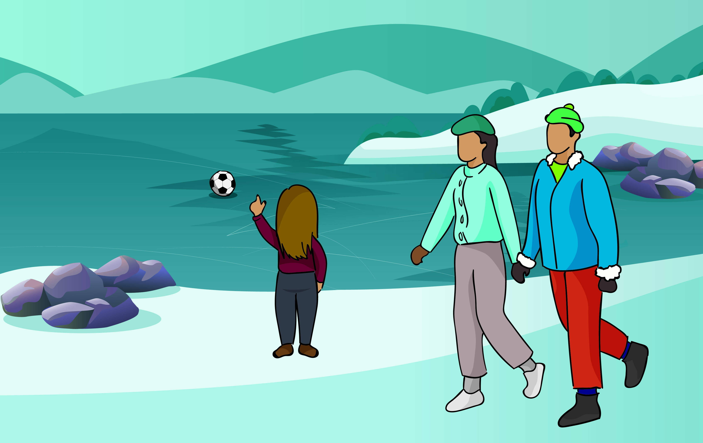
Stop and Think
Activity 2 Spot the dangers

Slide 6


Stay Together
Activity 3 Stay together, plan your day
Check list
What equipment would I bring?
Who would I go with?

Slide 7
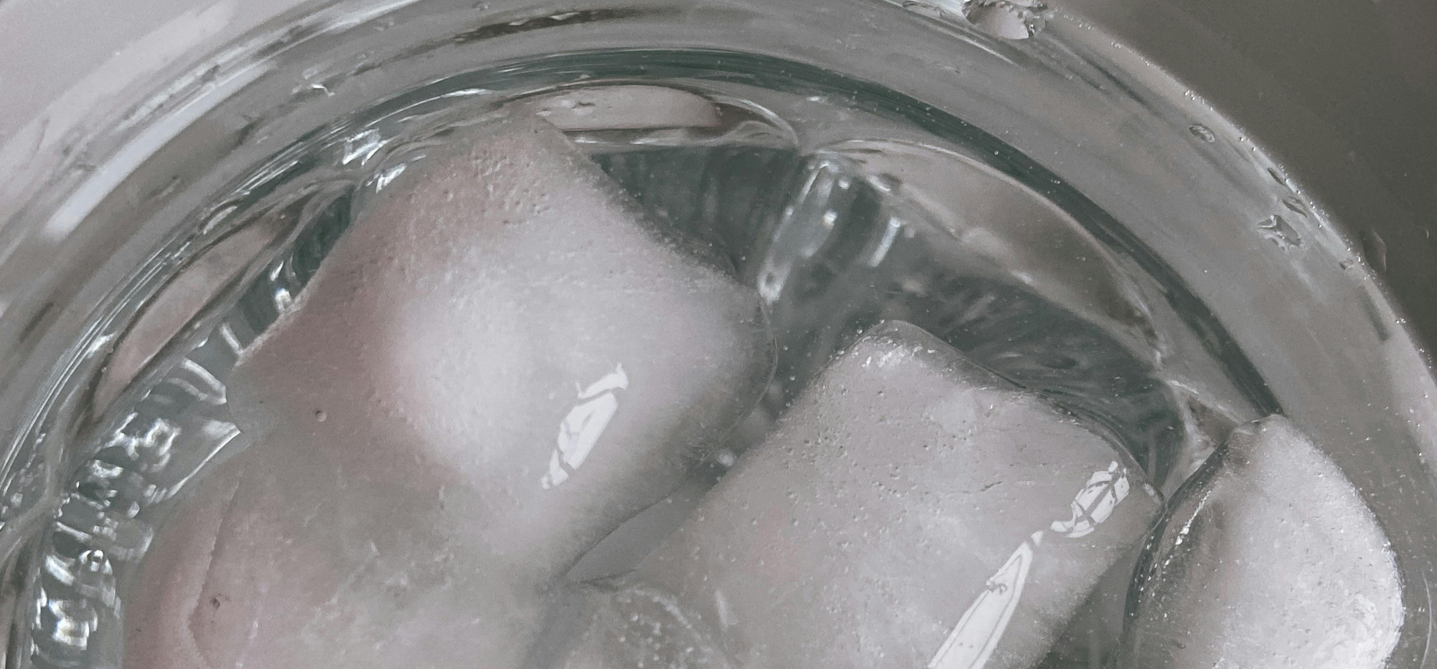
Activity 4 Cold Water Activity

Slide 8
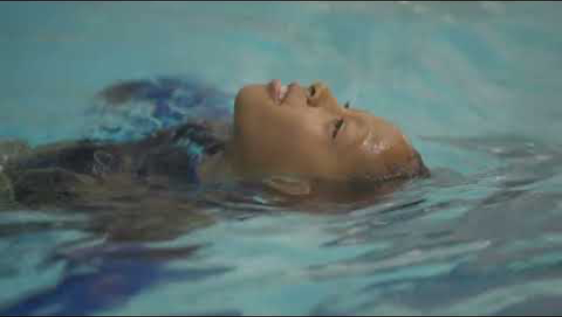
Activity 5 Float – Video – How to float

Slide 9
Activity 6 Call 999 in an Emergency (part 1)

Slide 10

Activity 6 Call 999 in an Emergency (part 2)
Audio recording of 999 call

Slide 11
Call 999
In an Emergency - Recap

Slide 12


True or False
Dangers are always easy to see
The water can be very cold in Wales, even in the summer holidays
Planning for the weather, wearing the right clothing and bringing equipment can make your day out safer
Staying near a parent/guardian near water will keep me safer
If I fall into cold water, I should float on my back until I get used to the temperature of the water and then shout for help or try to swim
It’s important to never go into
the water to help someone
– even a friend or pet
I should dial 999 in an emergency.

Slide 13



Three things I learnt today.
Two things I can tell someone about water safety.
One question I still have.
Reflection time

Slide 14
Summary of the Water Safety Code
Stop
and Think
Stay
Together
Float
Call 999 in an Emergency

